Slide 1
Space Flight

Slide 2
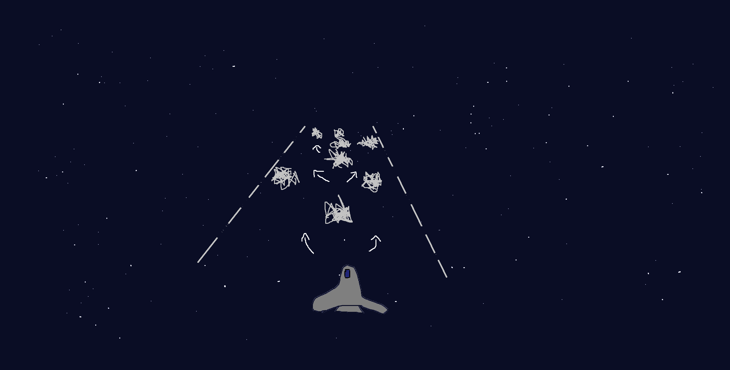
Design and Planning
High Score: 378
Score: 159
Figure 1.0. Game Design Sketch. Shows the planned view during gameplay. A is the player, B are the borders that mark the play area (the players cannot got outside of these), C are just a visualisation of the player movement during gameplay, and D are the obstacles to avoid.

Slide 3
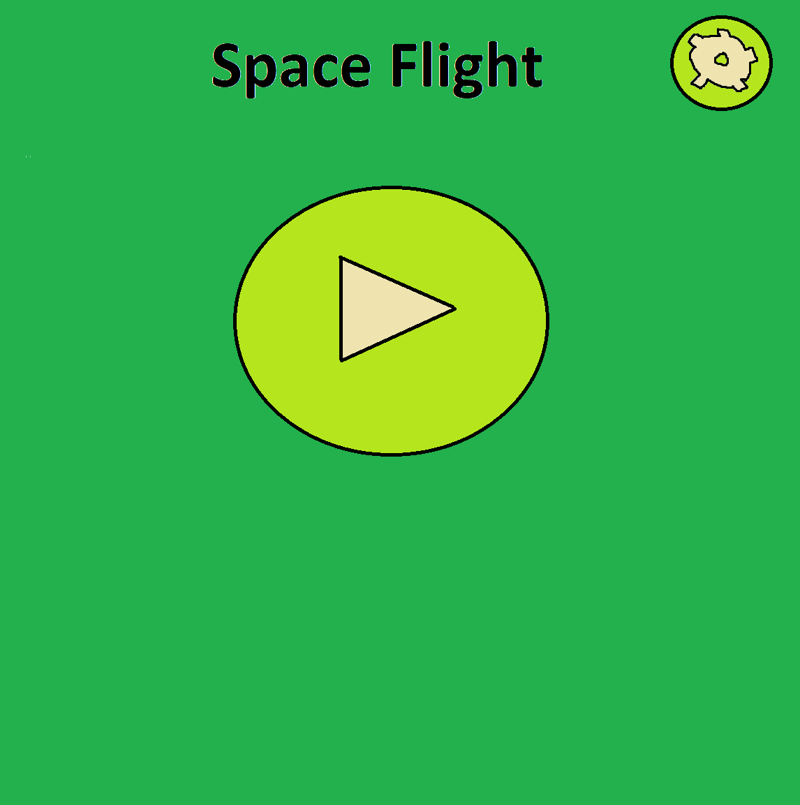
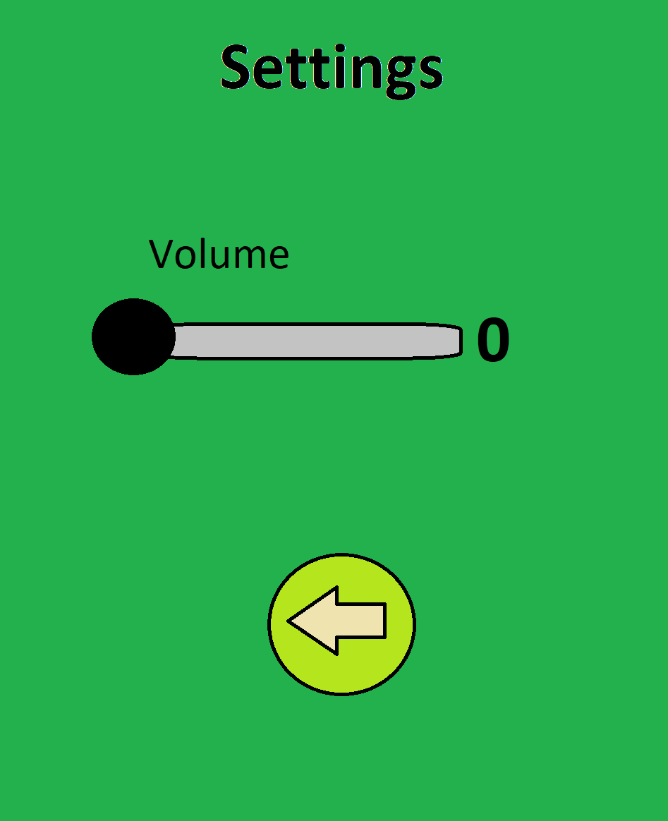
Design and Planning
Figure 1.1. Main and Options Menus. These show the initial design of the menus that I wanted to go for.

Slide 4
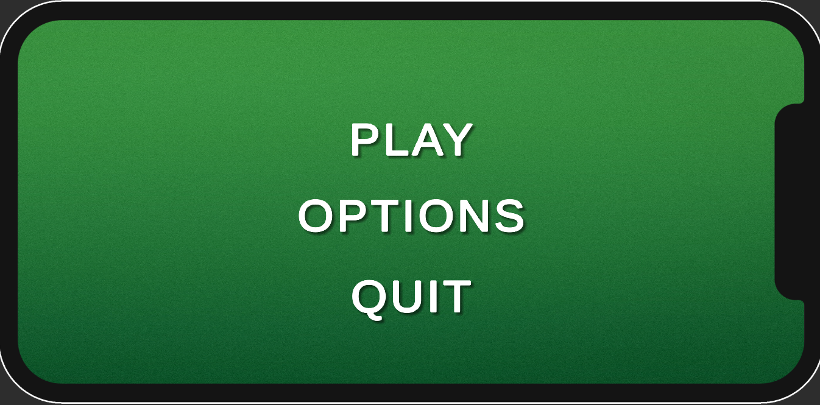
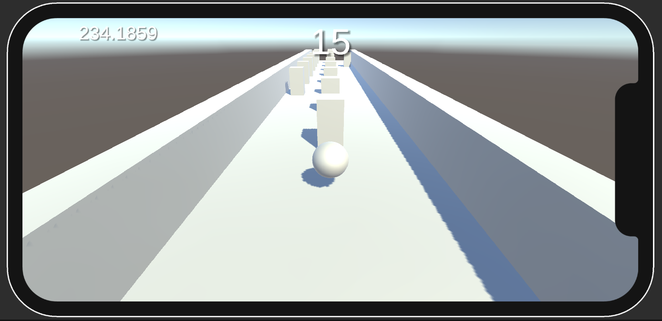
Evolution - Early Development

Slide 5
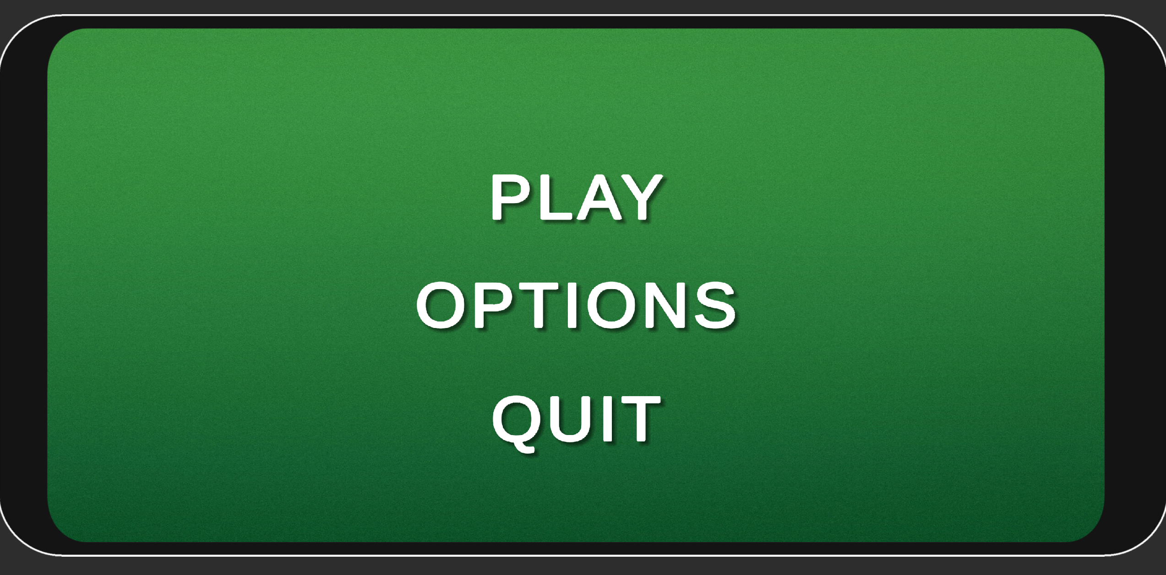
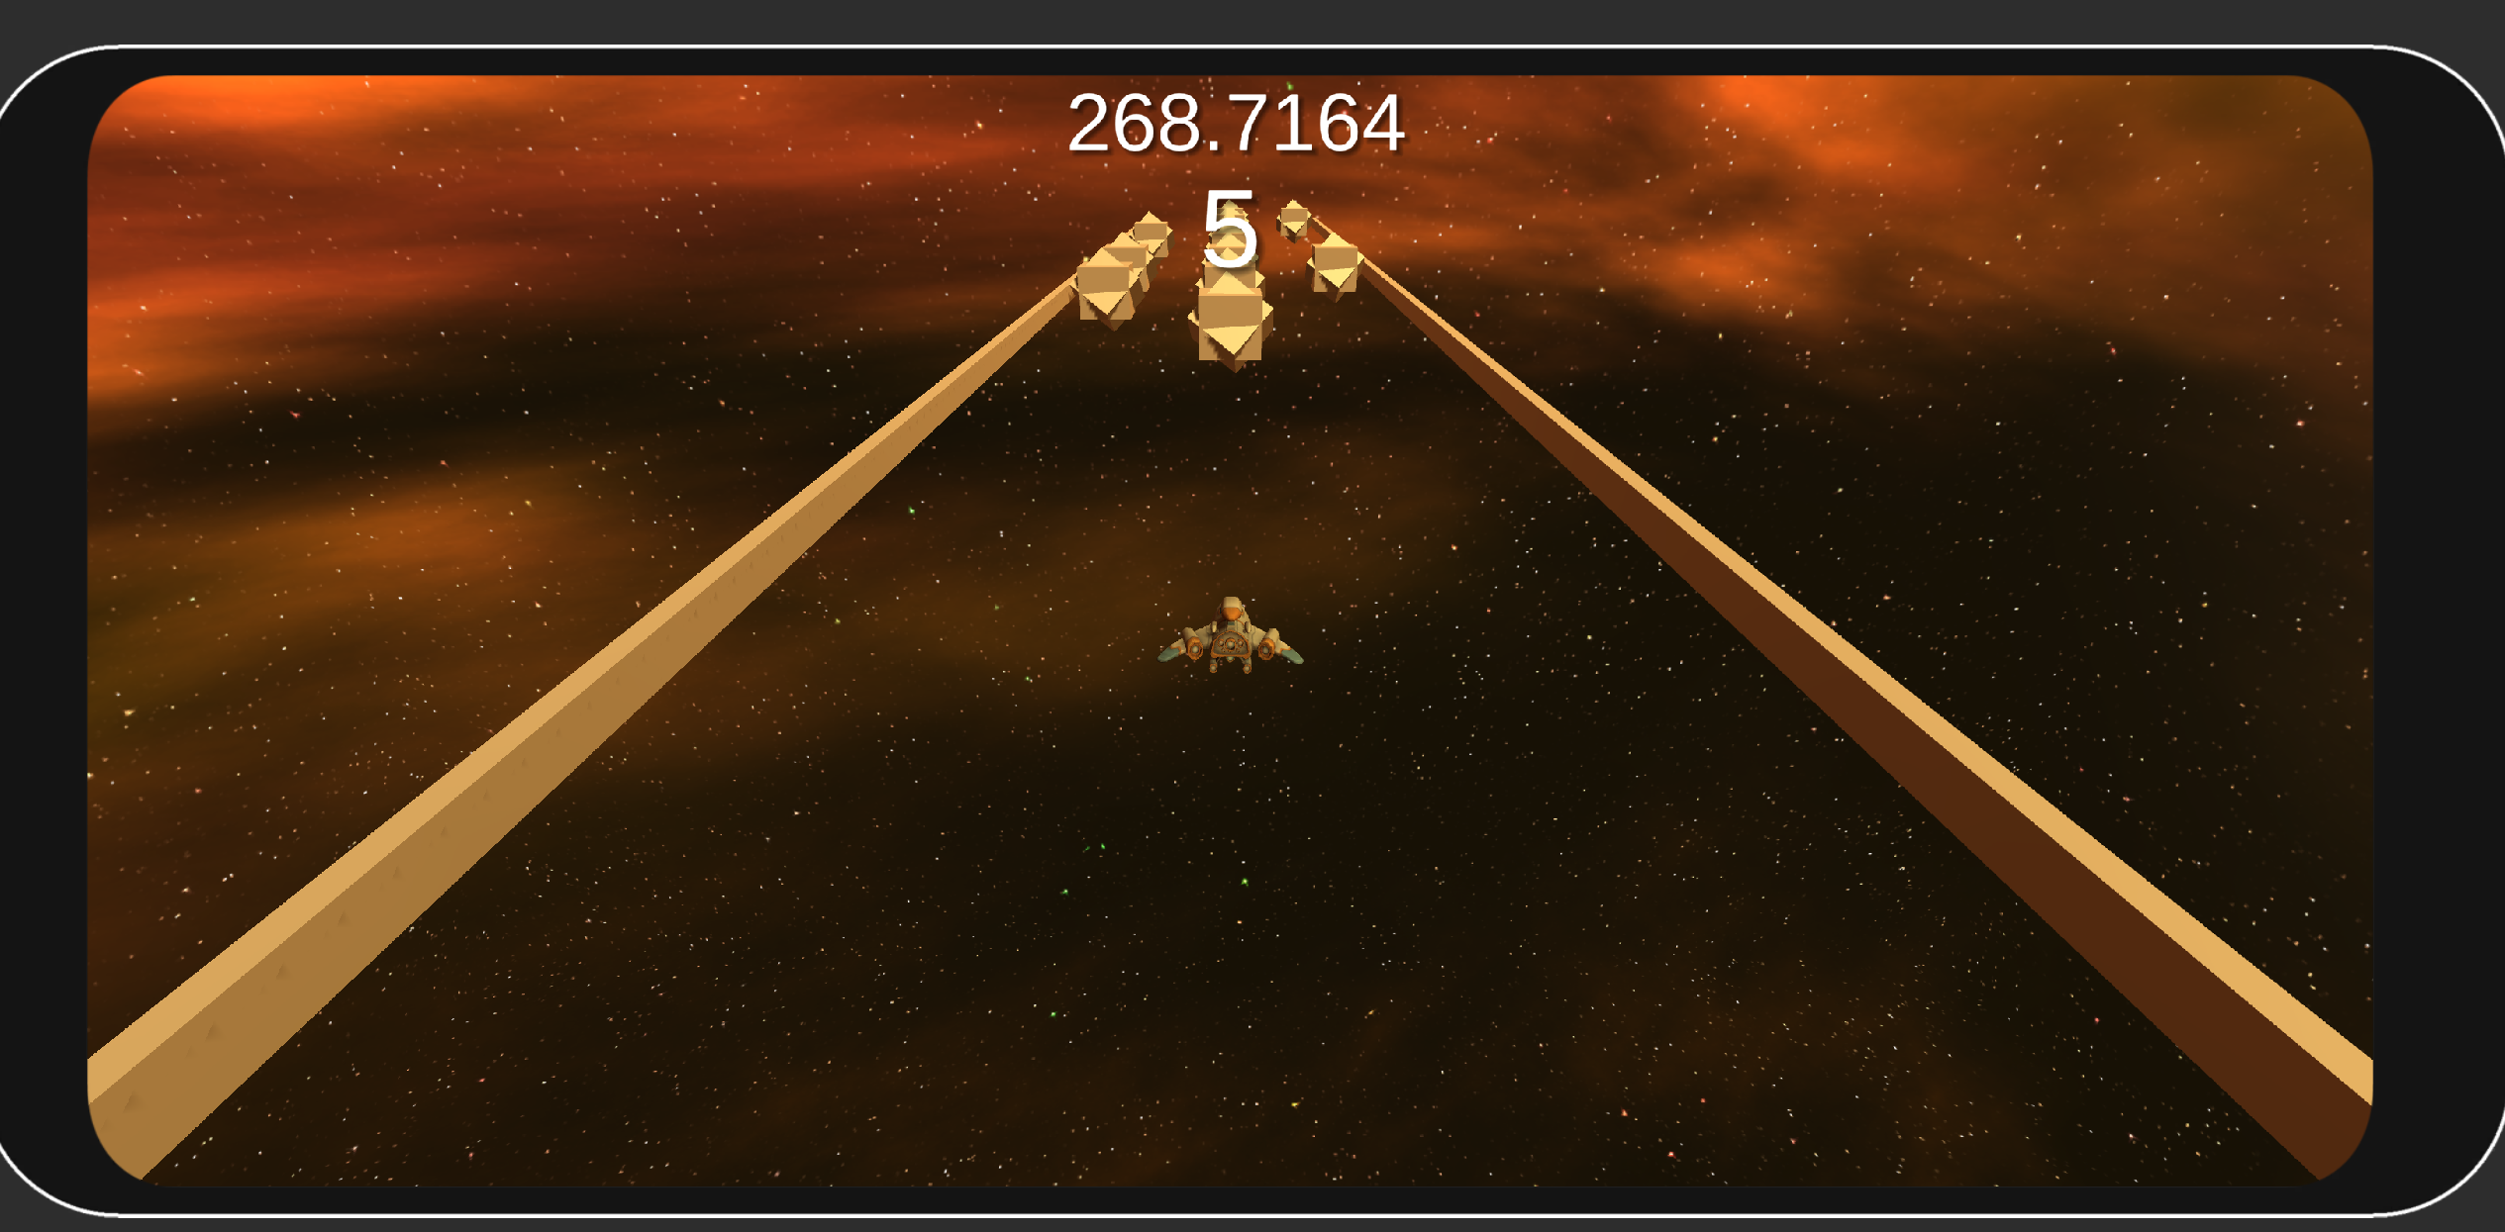
Evolution - The Prototype

Slide 6
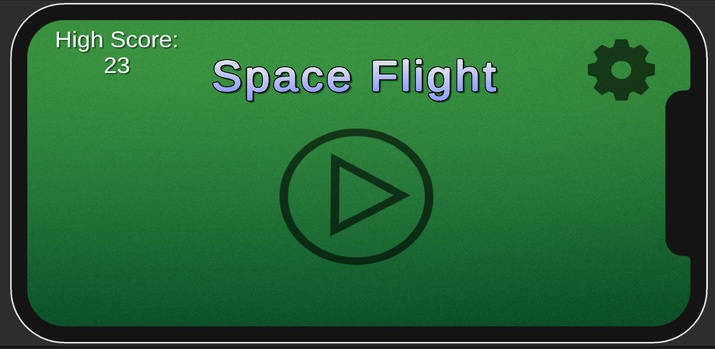
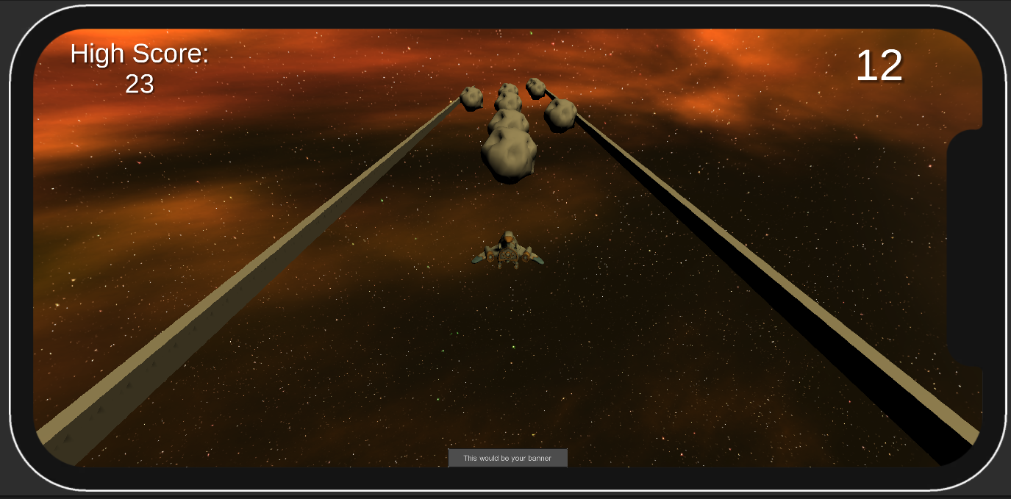
Evolution – Final Product

Slide 7
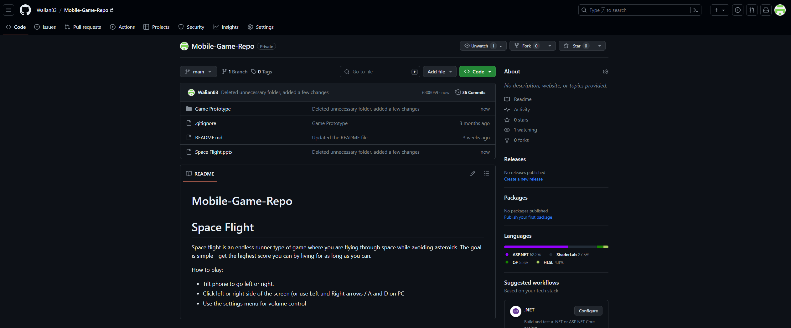
Github Repo

Slide 8
Target Platform + Frameworks
Testing on different devices through Unity simulator to ensure that the UI works on different screen sizes etc.
Monetization strategy through the use of Unity Ads framework – interstitial ad and banner ad
Looking into content guidelines – the game targeted towards kids however it does not contain prohibited content
Using accelerometer instead of gyroscope for battery consumption consideration

Slide 9
Improvements
Add pause and game over screens
Add audio to the game
Improve the UI by making it more visually appealing (e.g. Add a progress bar, play around with the fonts)
Add vibrations to the game (e.g. When a button is clicked or player collides with an obstacle)
Add rewarded ads (make the most out of Unity Ads, increase player satisfaction)
Add animation to the player when they move left and right

